Slide 1
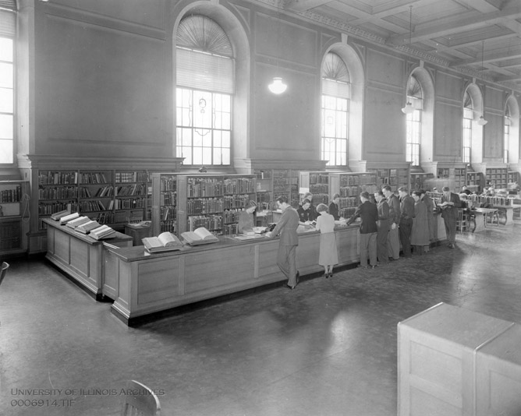
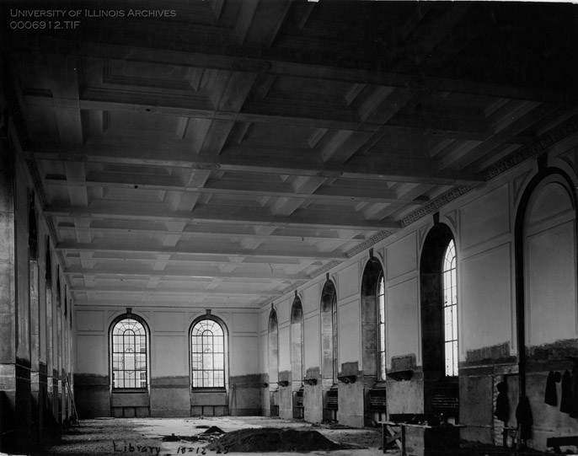
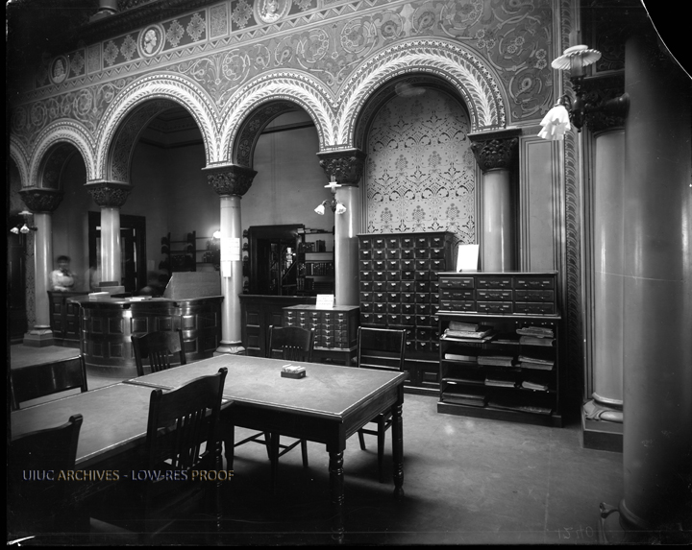
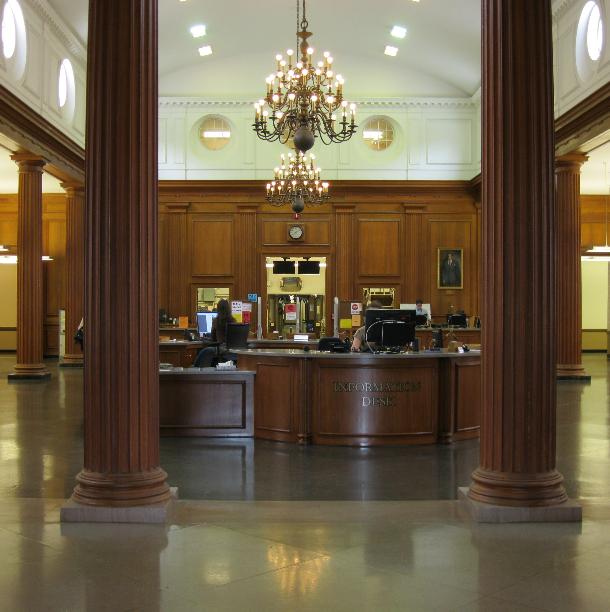
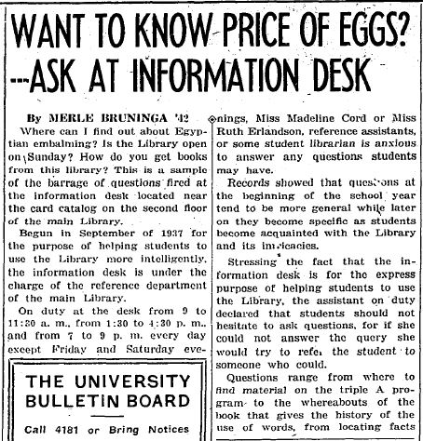
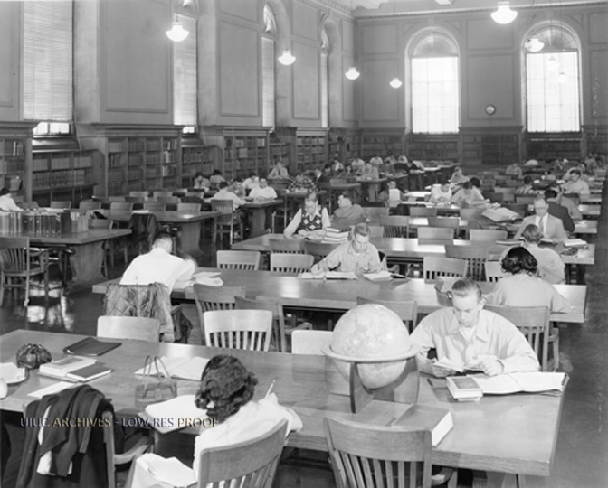
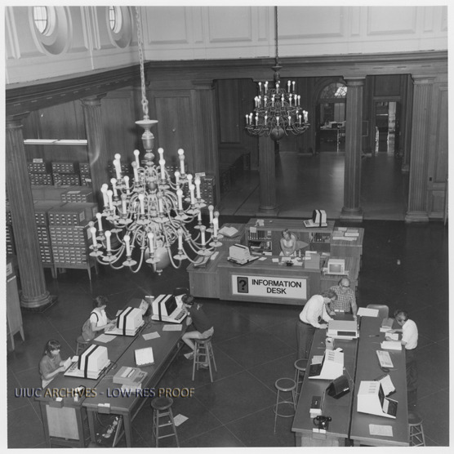
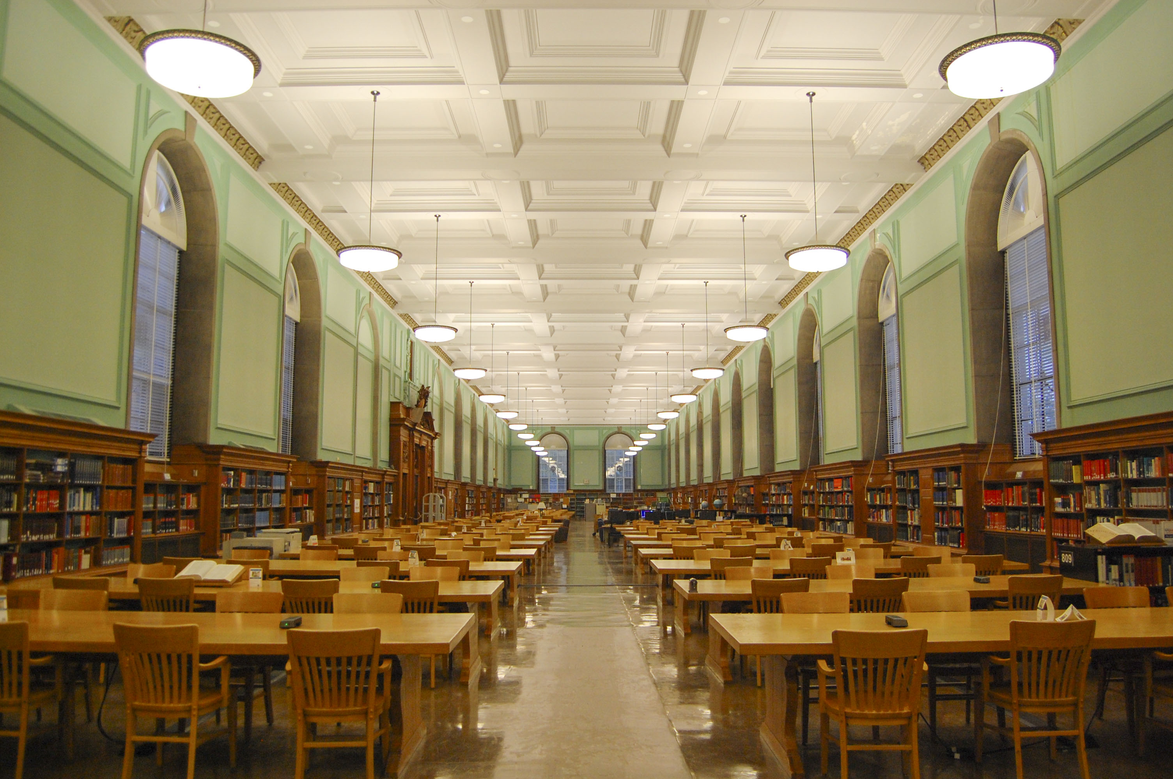

More than a Space:
A History of Central Reference Services at the University of Illinois Library
Sarah Hoover, Caitlin Crane, and JoAnn Jacoby
Reference, Research, and Scholarly Services, University Library, University of Illinois at Urbana-Champaign
http://explorecu.org/tour-builder/tours/show/id/15
Sept. 1897 – The first dedicated Library building on campus (now Altgeld Hall) is opened with the first professionally trained librarian of the university as its head and the first dedicated reference librarian on its staff.
Sept. 1926 – The Reference Department moves into the Reading Room of the new Library building. The reference desk is occupied by librarians available to answer in-person reference questions and to assist patrons in using the room’s resources.
Feb.-May 2001 – The Reference Department and Undergraduate Library test real-time chat reference. The service is continued and 4348 chat requests are received during 2001-02.
2003-04 – A new Information Desk is installed that is more consistent with the design and décor of the surrounding space of the Main Library.
2004-05 – The longstanding Reference Desk in the Reading Room is eliminated and in-person reference services are consolidated to the Information Desk.
1979 – The card catalog is discontinued and a terminal for the Library Computer System, which now handles circulation, becomes publicly accessible in the Reading Room. In 1980-81, over 150,810 searches are conducted.
1994-95 – The first networked public access terminal in the Reading Room becomes available.
1995-96 – An email reference service is introduced and is available from the Reference homepage. Initially it receives an average of 8-10 questions a month, but that number increases to 304 total question in 1998-99 and to 793 in 1999-2000 after the service moves to the Library gateway.
1999-2000 – The department develops a workshop on using the Internet for research as well as a website and tutorial on basic Internet research strategies.
Reading Room under construction,
Oct. 12, 1925
Reference desk in Reading Room, 1938
Summer 1916 – The Reference Department begins the practice of placing materials, such as railway literature, on a table for the benefit of travelers. These materials later become known as the “vacation collection.”
Sept. 1937 – A separate Information Desk opens in the central second floor area. Assistants at the desk focus on instructing patrons on the use of the card catalog and shelf list; helping patrons locate specific titles; suggesting subject headings for subject searches; and answering general information questions about campus and the library. 6,370 questions are recorded at this desk in its first year.
Mar. 1955 – A microfilm reader is installed in the Reading Room to make microfilms of the New York Times accessible to undergraduates.
1956 – Fluorescent lights are installed in the Reference Room, a change that is welcomed at the time for making it the “only sufficiently lighted public service area in the entire building to avoid eye strain.”
1965-66 – Air conditioning is installed in the Main Library.
The Library at Altgeld, circa 1900
1897
1897-1926: Reference questions are answered in-person, through correspondence, and later by phone. The Library fields questions from other libraries, government organizations, school-age students, business firms, and women’s clubs, as well as from Illinois students and faculty.
1926-1950: The popular practice of putting out a “vacation collection” of useful travel materials on tables in the Reading Room during the summer continues. During World War II, questions are frequently received relating to the war effort from officers and enlisted men and bibliographies on post-war planning are created.
1940-1955: The Department deals with two frequent issues: first, the practice of sororities and fraternities requiring mandatory study hall hours for pledges in the Reading Room and second, the noise from smokers congregating on the library stairwell when smoking was allowed in the building.
1951-1975: Librarians in the Reference Department continue an earlier practice of creating materials for library instruction, including the “Handbook for Graduate Students and Members of the Faculty” and “How to find a book.” The “Introduction to Library Use” course also continues to be taught during this period, a practice first begun when the Library in Altgeld Hall opened.
Spring 2011 – A separate desk is established to handle the bulk of chat questions. In 2012-13 between the Information Desk and the centralized Virtual Reference Desk, 11,444 chat questions are answered.
Fall 2013 – New lighting fixtures are installed in the Reading Room to replace the old fluorescent lights, bringing the room closer to its original appearance.
1951-1975: The department maintains its popular summer “vacation collection” throughout much of this period, offering travel folders which patrons could take with them and maps with locations of Illinois state parks.
  Information Desk, 2013
1976-2000: Computers and then the Internet change the types of resources available for research. In 1976, the library gets computer terminals for searching large bibliographic databases, and August 1978 brings the New York Times Information Bank. Later, in the 1990’s, an Electronic Reference Sources homepage becomes the centralized source for databases licensed by the Library, as well as for free websites useful for research.
The Daily Illini; Dec 1,1939
Reading Room, circa 1952
Historical images courtesy the University of Illinois Archives, copyright the University of Illinois or unknown
Information Desk, circa 1979
Reading Room, 2014

